Slide 1




Graduation
Project
Q-
EASE

Slide 2

AGENDA
1- Introduction
2- Key Features
3- Problem
4- Solution
5- Main Idea
6- Why Q-Ease
7- Demo
8- Future Improvements
9- Pre-trained Models Used
10- Conclusion
11- Meet Our Team

Slide 3

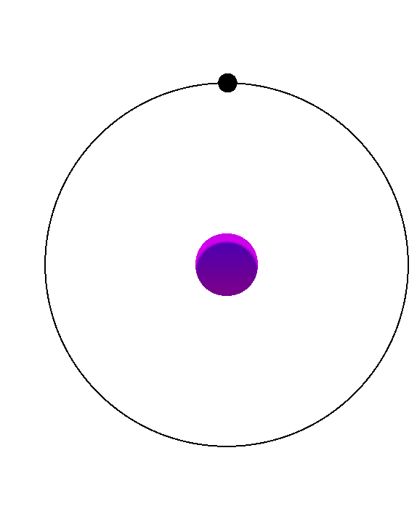
Q-Ease
INTRODUCTION
In today’s educational environment, students sometimes struggle with learning difficult courses such as biology and chemistry. We have created a unique Question Answering (QA) model to help students in their academic pursuits because we understand these challenges. This model facilitates a greater understanding of scientific material by creating personalized questions and providing accurate answers.

Slide 4
Q-Ease
Student-Centric Approach: Especially designed to meet each student's particular learning needs.
Subject-Specific Focus: Concentrates on scientific disciplines, ensuring relevant and contextual assistance.
Empowerment via Knowledge: Seek to enhance self-assurance, confidence and self-directed learning in students.
KEY
FEATURES

Slide 5
Q-Ease
Our project reflects a commitment to student success, making science education more accessible and engaging.

Slide 6

PROBLEM
Students frequently encounter significant challenges in preparing for exams due to the limitations of traditional assessment methods.
The following issues contribute to ineffective study practices and hinder true understanding of the subject matter:

Slide 7

PROBLEM
Limited Variety of Questions: Practice exams and standard revision resources frequently have a limited number of questions, which results in content that is repeated and promotes rote memory over true comprehension.
Inadequate Coverage of Content: Many traditional resources don't cover all the ground necessary for comprehensive exam preparation, leaving gaps in students' knowledge and comprehension.
Uneven Evaluation of Abilities: The reliance on static resources can lead to an imbalanced assessment of students' capabilities, leaving them inadequately prepared for the diverse nature of exam questions they may encounter.

Slide 8
Q-Ease
These challenges highlight the need for innovative solutions that provide a more dynamic and comprehensive approach to exam preparation, ultimately fostering deeper learning and better outcomes for students.

Slide 9
SOLUTION:
INNOVATIVE APPROACH TO EXAM PREPARATION
To address the challenges faced by students in effective exam preparation, we propose an innovative solution that leverages technology to enhance learning and assessment practices:

Slide 10

Dynamic Question Generation: Generates a wide range of questions that are suited to the particular subject areas that students are studying. This method promotes deeper knowledge and critical thinking while reducing rote memory.
Comprehensive Content Coverage: Our model makes sure that all pertinent information is covered by utilizing an extensive collection of scientific topics database, giving students a comprehensive understanding of the subject.
Adaptive Learning Pathways: Effective learning outcomes are promoted by the system, which adjusts to each student's individual learning style and pace to provide personalized study plans that focus on their areas of strength and weakness.
Real-Time Feedback: Immediate feedback on practice questions encourages students to take a more proactive approach to studying by assisting them in identifying areas for growth.

Slide 11
Q-Ease
This multifaceted solution aims to empower students by providing them with the tools they need to succeed in their exam preparations and develop a deeper understanding of scientific concepts.

Slide 12
MAIN IDEA
The main idea of our project is to revolutionize the way students prepare for exams by addressing the limitations of traditional assessment methods. By implementing a technology-driven approach that focuses on dynamic question generation, comprehensive content coverage, and adaptive learning pathways, we aim to:

Slide 13

Foster True Understanding: Move beyond rote memorization to promote genuine comprehension of scientific subjects.
Q-Ease
Bridge Knowledge Gaps: Ensure that students are well-prepared for a variety of exam formats and question types.
Support Individual Learning Needs: Tailor the study experience to each student's unique requirements, enhancing their confidence and competence in the subject matter.

Slide 14
Q-Ease
Through this innovative approach, we strive to create a more effective and engaging learning environment that ultimately leads to improved academic performance and a lifelong love for science.

Slide 15
WHY TO USE Q-EASE MODEL?
Our innovative approach to exam preparation offers a multitude of benefits that set it apart from traditional methods. Here are some compelling reasons why our model is the ideal choice for students, educators, and institutions:

Slide 16

FOR STUDENTS
Improved Learning Outcomes: Our model fosters a deeper understanding of scientific concepts, leading to better academic performance and increased confidence.
Personalized Learning Experience: Adaptive learning pathways ensure that each student receives a tailored study plan, catering to their unique needs and learning style.
Enhanced Engagement: Interactive and dynamic question generation keeps students engaged and motivated, making the learning process more enjoyable.

Slide 17

FOR EDUCATORS
Facilitating Inquiry-Based Learning: Educators can use our model to encourage students to ask questions and explore topics deeply, fostering a culture of curiosity and critical thinking.
Resource for Answers: Educators can easily enter the question and check whether the student’s answer is correct or incorrect.

Slide 18

FOR INSTITUTIONS
Improved Student Retention: Our model enhances the learning experience for students, making it more effective and engaging, which aids institutions in lowering dropout rates and bolstering student retention.
Enhanced Reputation: nstitutions embracing our model showcase their dedication to innovation and student achievement, thereby boosting their prestige and drawing in exceptional talent.
Cost Savings: Our model diminishes the reliance on conventional assessment materials and lessens the administrative load on educators, leading to financial savings for educational institutions.

Slide 19
Q-Ease
By choosing our model, students, educators, and institutions can unlock the full potential of students, leading to improved academic outcomes, increased engagement, and a more effective learning environment.

Slide 20
DEMO

Slide 21
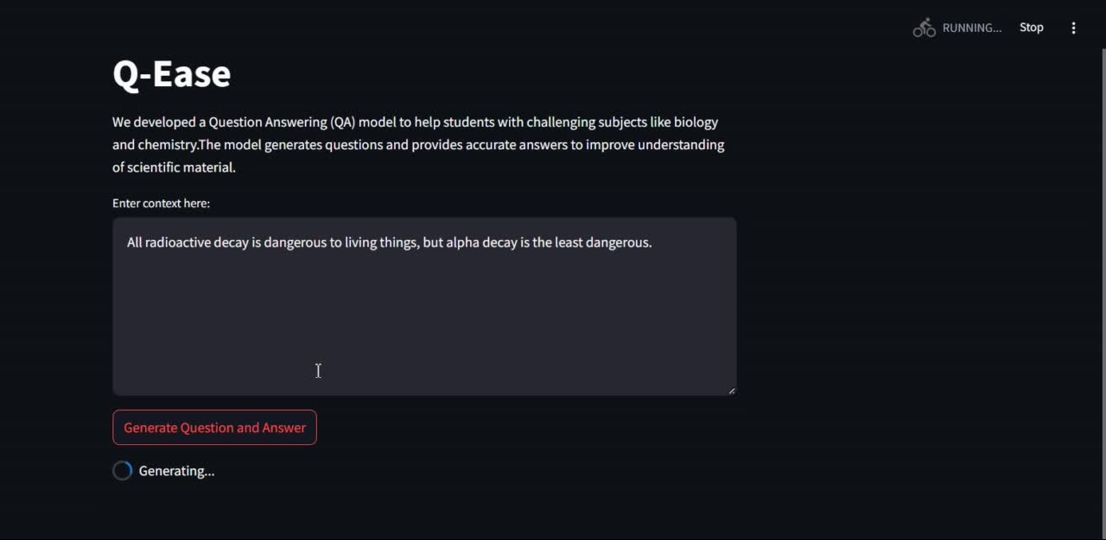

Slide 22

FUTURE IMPROVEMENTS
01. Generate multiple choices based on a given subject for all years of study.
02. Generate a voice system to listen to students while rehearsing what they know and correct them when something is wrong.
03. Enable students to upload specific chapters or curriculum to generate personalized questions and answers. This feature will allow for targeted exam preparation, aligning the practice material with the student's study needs and making the system adaptable to various subjects.

Slide 23
PRE-TRAINED MODELS WE TRIED WITH THIS PROJECT
google/flan-t5-large ‘used in our project’
google/flan-t5-small
google/flan-t5-medium
google/flan-t5-xl
google/flan-t5-xxl
google/flan-t5-base
google-t5/t5-base
google/pegasus-large
distilbert/distilgpt2
facebook/bart-base
PaLM, a transformer-based model by Google
BERT, introduced by Google

Slide 24
CONCLUSION
our innovative question answering model represents a transformative approach to education that empowers students, supports educators, and enhances institutional effectiveness. By providing immediate access to information and fostering a culture of inquiry, we enable students to take charge of their learning journey, leading to improved academic outcomes and increased engagement.
Together, we can unlock the full potential of students and create a more effective and engaging learning environment for all.

Slide 25
1- Ayah Tarek
2- Marcel Azmy
3- Merna Albert
4- Nada Hassan
5- Nada ELSayed
MEET OUR TEAM
SUPERVISED BY
Mr. Mohamed Agoor

Slide 26
THANK YOU!

